Slide 1


Marathwada Mitra mandal’s
COLLEGE OF ENGINEERING
Karvenagar, Pune
An Autonomous Institute
Presentation On
Financial Management Tool: Develop a web-based tool for personal finance management ,integrating budgeting, expense tracking, and financial goal setting with a clear and intuitive interface

Slide 2
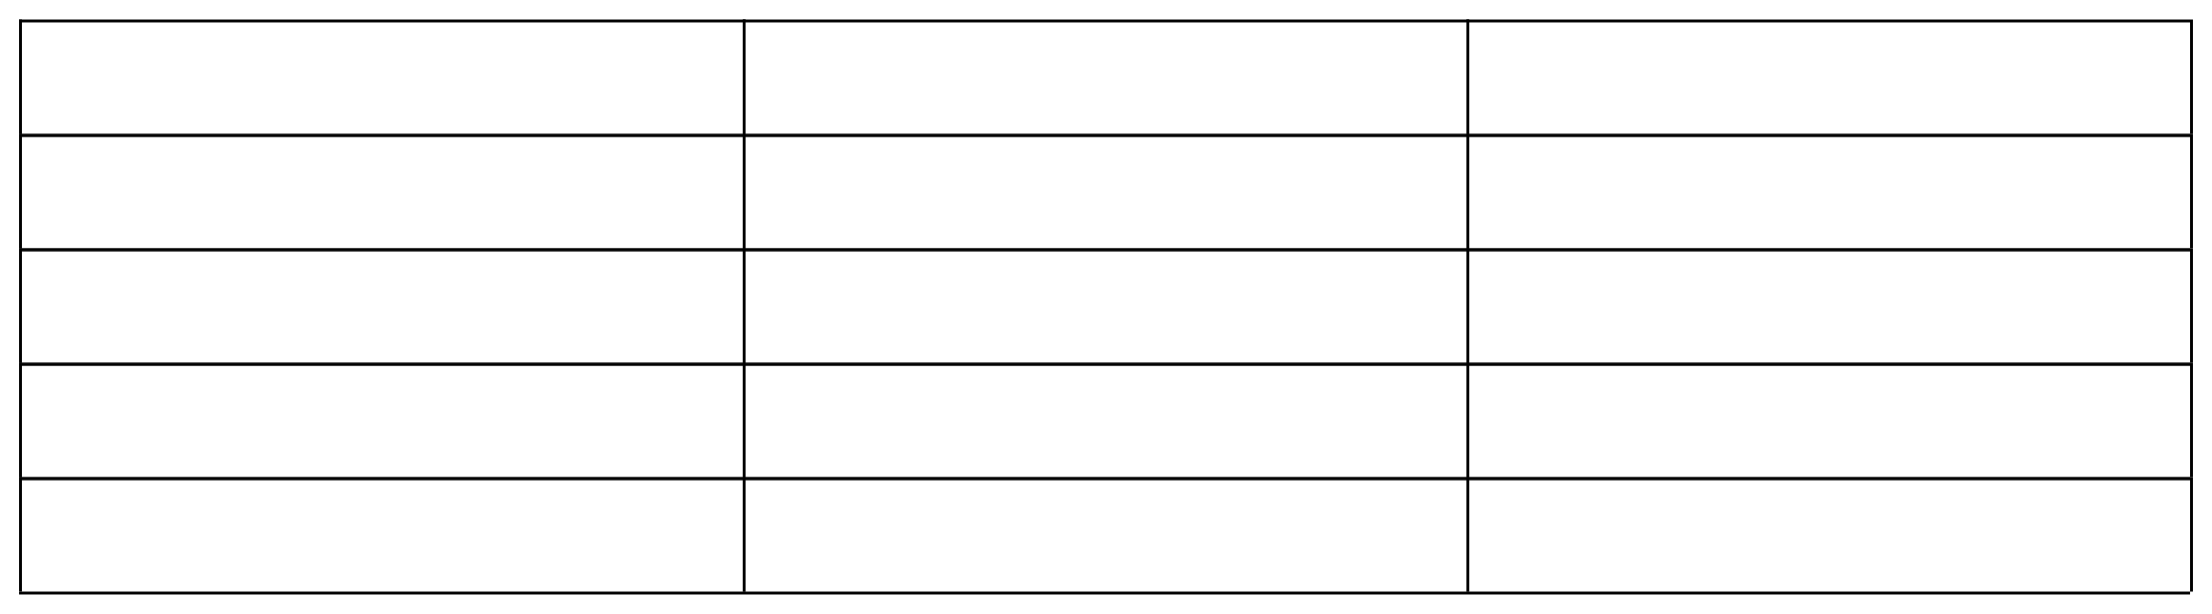
Group Information
Sr. No .
PRN No.
Name of students
1
B24IT1046
Sharvari Aralkar
2
B24IT1129
Gayatri Muttepawar
3
B24IT1128
Shrawani Aherwal
4
B24IT1052
Ishwari Desai

Slide 3
Introduction
Effective financial management is essential for the success and sustainability of any organization or project. In an increasingly complex and competitive environment, the ability to plan, monitor, and control financial resources plays a vital role in achieving both short-term goals and long-term strategic objectives. Financial management tools are systems, techniques, or software used to facilitate budgeting, forecasting, investment analysis, cost control, and financial decision-making.
This project focuses on exploring various financial management tools that help individuals and organizations manage their finances more effectively. Tools such as budgeting software, financial modeling applications, expense tracking systems, and performance dashboards are examined in terms of their features, benefits, and real-world applications.

Slide 4
Objective
To design an intuitive and engaging user interface that enables users to monitor their finances, visualize expenses, and build better budgeting habits. The project focuses on creating a realistic, front-end-only prototype that addresses the needs of both individual users and their guardians through smart and accessible UI features.
Following are the objectives of financial management tool:
To design an intuitive and engaging user interface for a financial management tool.
To enable users to monitor their finances effectively.

Slide 5
To provide clear visualization of expenses for better financial awareness.
To help users develop and maintain budgeting habits through smart UI design.
To create a realistic, front-end-only prototype focusing on user interaction and experience.
To address the needs of both individual users and their guardians through accessible and inclusive design features.

Slide 6
Feature (Module Description)
1. Budgeting and Forecasting:
This module covers tools and techniques used to plan future income and expenses. It includes the use of spreadsheets and budgeting software to create monthly and annual budgets, track spending, and forecast future financial outcomes based on historical data.
2. Expense Tracking:
This module focuses on monitoring daily, weekly, and monthly expenses. It includes tools that categorize expenses, generate reports, and help users identify unnecessary costs or overspending habits.
3. Financial Analysis and Reporting:
In this module, users learn how to interpret financial data using key metrics and ratios.

Slide 7
4. Investment Evaluation:
This module introduces tools used to evaluate potential investments through methods such as Net Present Value (NPV), Internal Rate of Return (IRR), and Payback Period. It helps in assessing the financial feasibility of projects or business ideas.
5. Risk Management:
This module explains how to identify, analyze, and mitigate financial risks. It includes tools that simulate different scenarios and stress-test financial plans to ensure better preparedness for uncertainties.
6. Software Tools Overview:
This module provides hands-on insights into popular financial management software such as Microsoft Excel, QuickBooks, Tally, and other project finance apps. It compares their functionalities, ease of use, and application areas.

Slide 8
Functional and non-functional requirement
1. Functional requirements:
1. Budget Creation and Management:
Easily create personalized budgets to manage your monthly spending. Adjust and track your allocations in real time for better financial control.
2. Expense Tracking:
Automatically log and categorize expenses to monitor where your money goes. Get daily summaries and alerts for unusual activity.
3. Financial Goal Setting:
Set short-term and long-term financial goals like saving for a vacation or paying off debt. Track your progress with visual indicators and motivational reminders.

Slide 9
4. Reports and Insights:
Access detailed reports and analytics on your income, spending, and saving habits. Gain actionable insights to improve your financial health.
5. Integration with External Accounts:
Securely connect your bank accounts, credit cards, and digital wallets. Sync transactions in real-time for a complete financial overview.
6. Data Export:
Export your financial data in multiple formats (CSV, PDF) for sharing or backup. Ideal for tax season or detailed personal analysis.

Slide 10
2. Nonfunctional requirements:
1.Usability:
The app should offer an intuitive, user-friendly interface for effortless budgeting, tracking, and reporting. Clear navigation and personalized dashboards enhance user satisfaction.
2.Performance:
The app must load quickly and process transactions or reports efficiently. Smooth real-time syncing ensures seamless financial tracking.
3.Reliability:
Users must consistently access accurate data without app crashes or downtime. Reliable alerts and reminders support timely financial decisions.

Slide 11
4.Security and Privacy:
Robust encryption and authentication protect sensitive financial data. Compliance with regulations ensures user trust and data confidentiality.
5.Scalability:
The system should handle growing user bases and expanding features without performance degradation. It must support evolving financial tools and integrations.
6.Data Backup:
Automatic, regular backups prevent data loss in case of failures. Users should have easy access to restore previous financial records if needed.

Slide 12
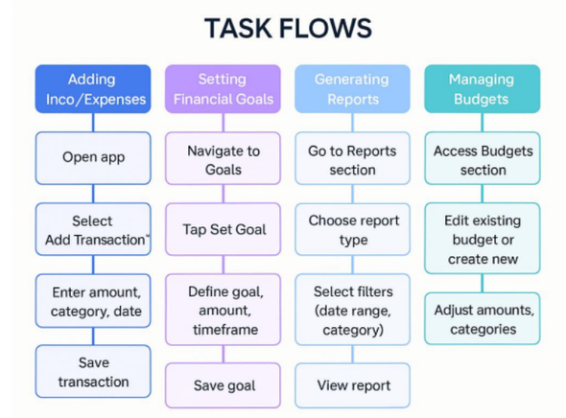
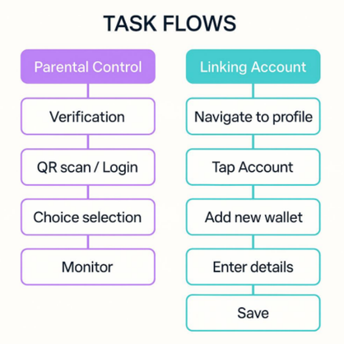
Task Flows
TASKFLOWS
TASKFLOWS

Slide 13
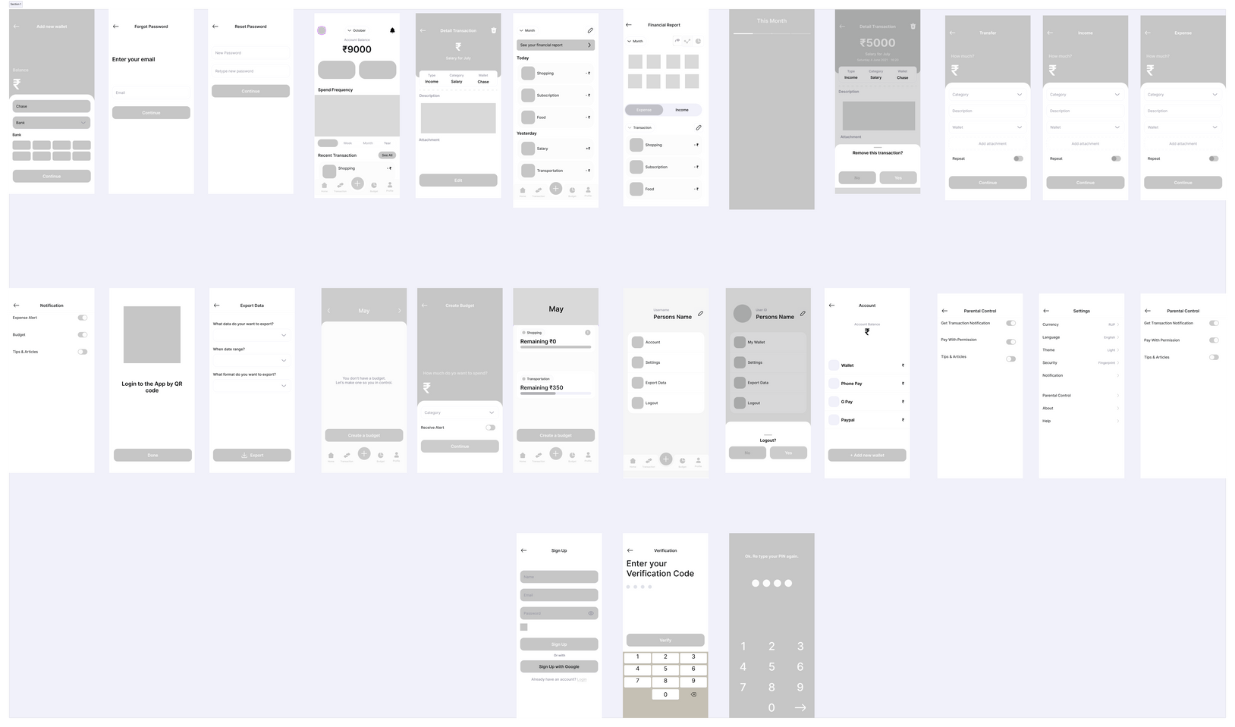
Low-Fidelity Wireframes

Slide 14
Link of Prototype
https://www.figma.com/proto/hFMuV0D9V1ydxMpcOXr1qJ/CU%20RRENT?node-id=0-1&t=XFYLmuQhf1tuSqzE-1

